Slide 1
Family Prayer Bag
Diocese of Northampton Northampton Religious Education Service

Slide 2
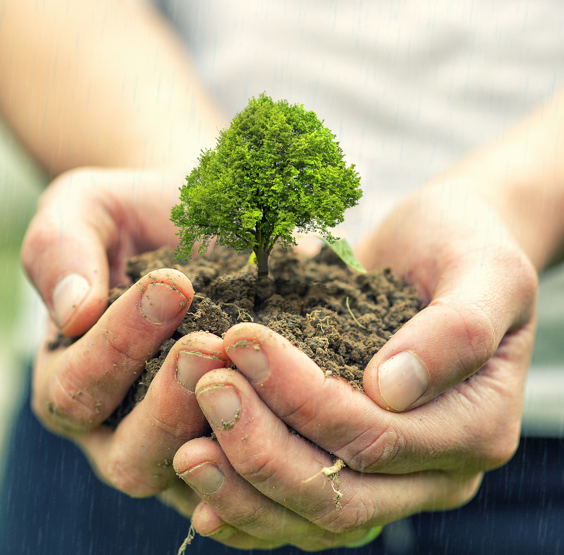
Praying together
Working together in the light of the lord
We believe in the importance of prayer and coming together as a family to pray to God. Due to the current circumstances we can no longer send home our usual prayer bags. We encourage you to use this PowerPoint to guide you and your family to spend time together with God.
Prayer is a central part of school life at St. Martin’s and children experience prayer through many forms, for example; words, actions, symbols, music and drama.
Children are invited to pray privately and as a community, as prayer unites us as members of the Family of God.
The children learn a range of prayers and they pray many times during the school day. Every class has a prayer bag and children share and write prayers at home with their families which they then bring in to school to share with their peers.
Notes:
Tags: statement, vision, overview, left aligned text, right aligned image

Slide 3
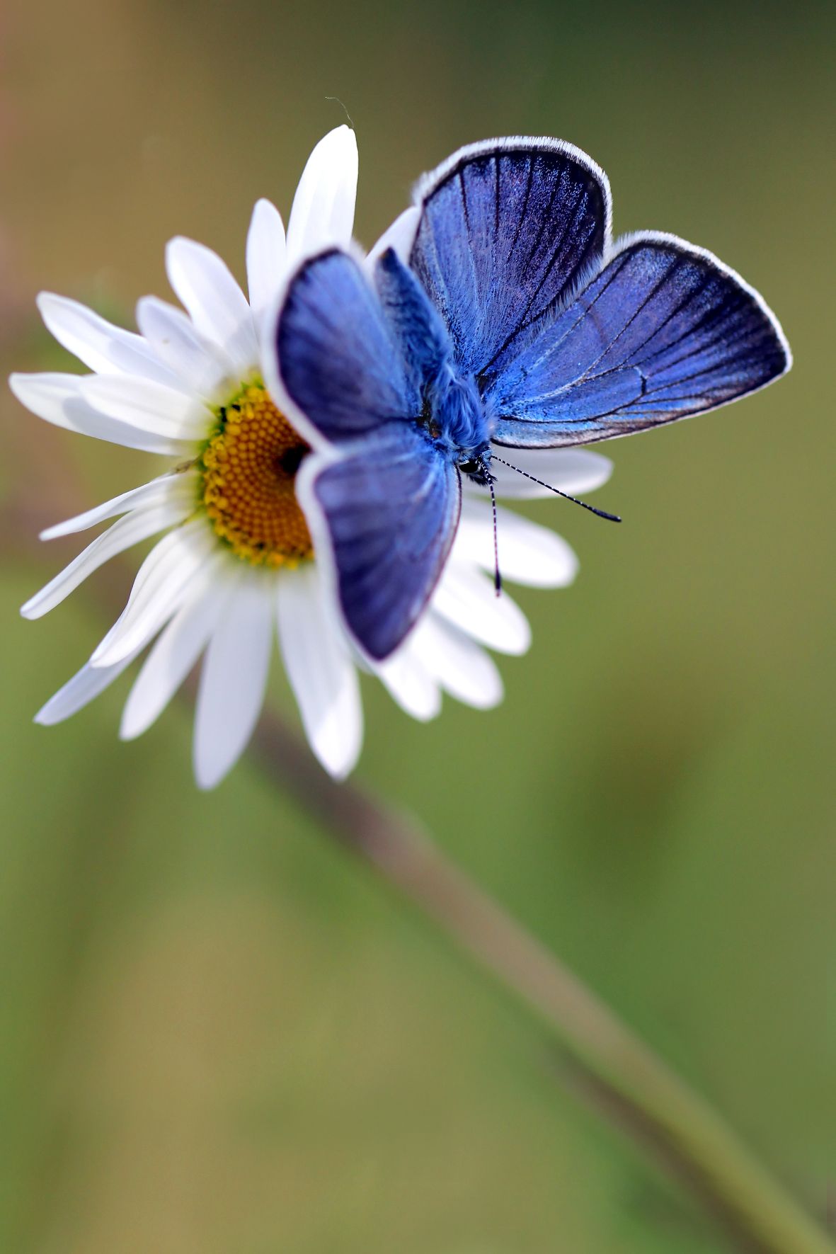
Getting Ready
Working together in the light of the lord
When getting ready to pray we recommend that you have:
✓ | A blue cloth – the colour which reminds us of the life of Mary the mother of Jesus
✓ | A cross – to remind us of the person of Jesus
✓ | A finger rosary – a sign of prayer, and of Mary, the Mother of Jesus
✓ | If you can do so safely, light a candle or a tea light reminding us that Jesus is present when we gather to pray together
✓ | A prayer card, Time for You, Lord – this is for anyone to use at other times of the day

Slide 4
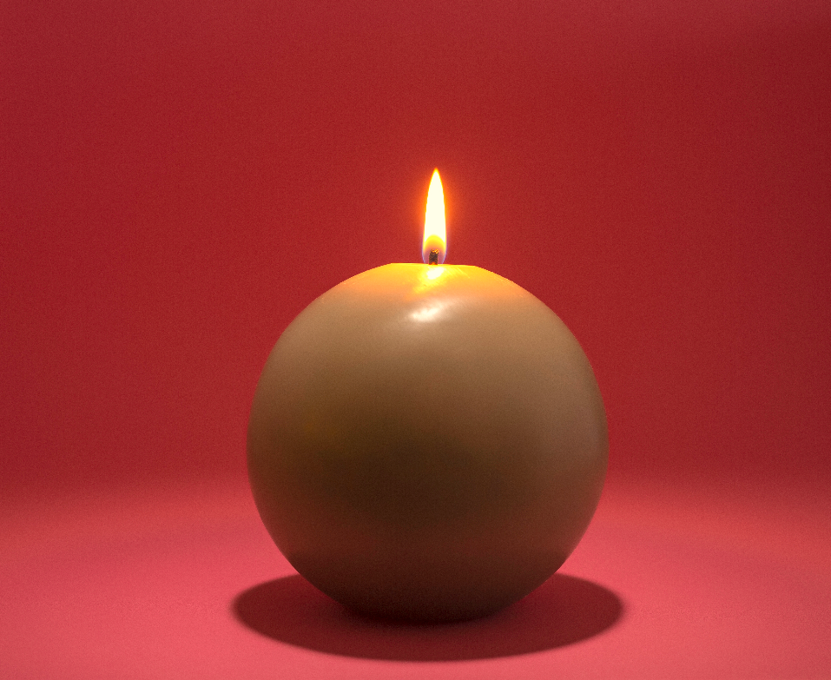
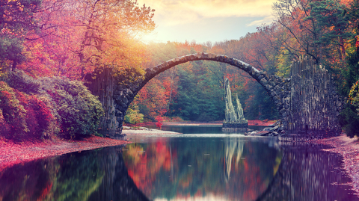
We Gather
Working together in the light of the lord
When you come together to pray we recommend that you:
1
2
3
Set up your prayer table
Let the children spread out the cloth and put your special objects on it.
Get comfortable
Each member of the family should get into a comfortable position around the prayer focus and sit quietly to create an atmosphere of prayer.
Make the sign of the cross together.
In the name of the Father and of the Son and of the Holy Spirit. Amen
4
5
Set our intentions
A family member now says: Today we are thinking about the family of God throughout the world.
Celebrate joy
Take it in turns to talk about the joyful things that have happened in your family e.g. births, celebrations, holidays, family fun stories etc.

Slide 5
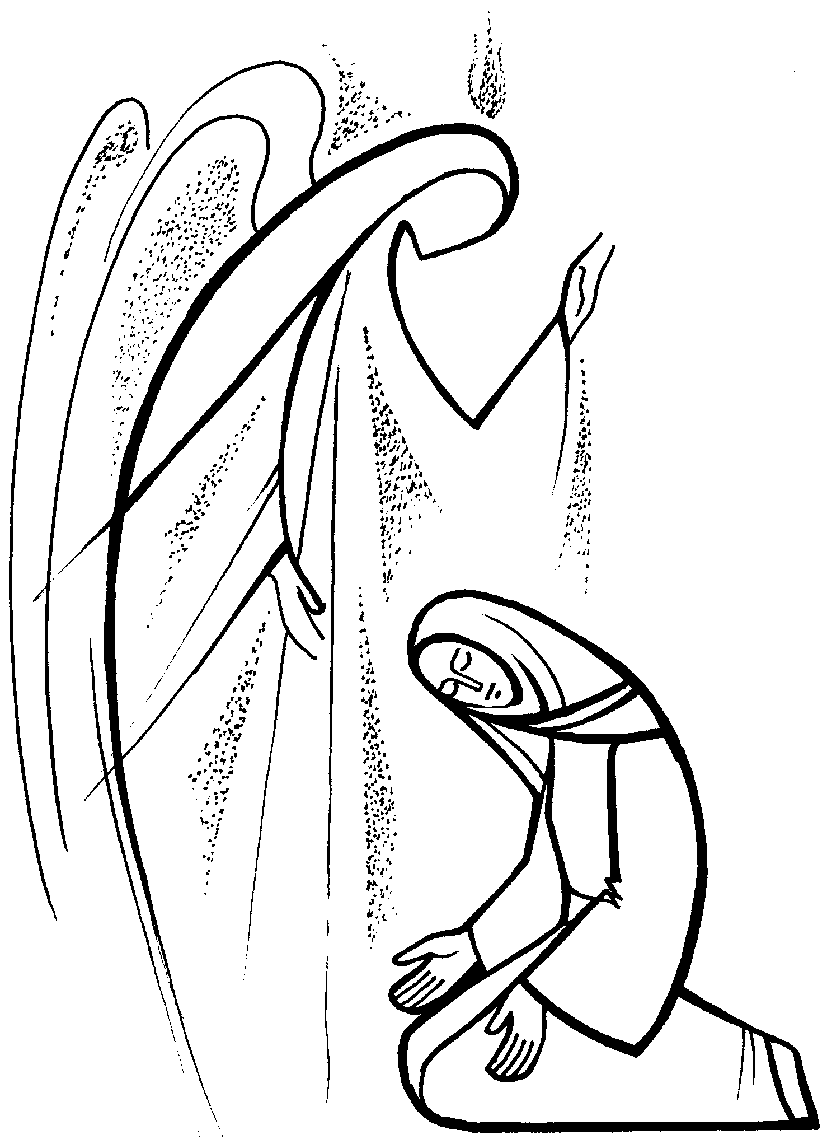
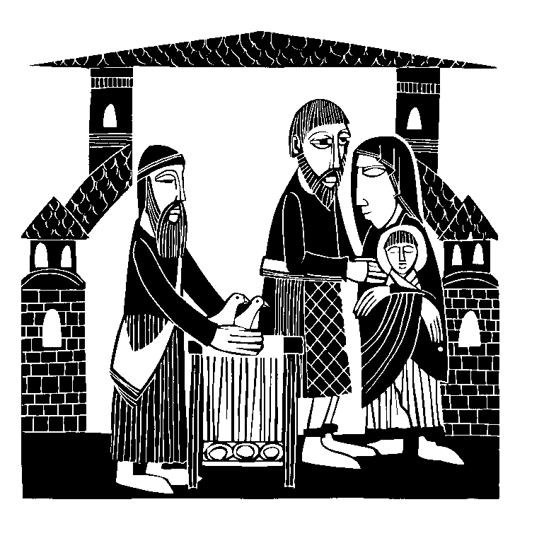
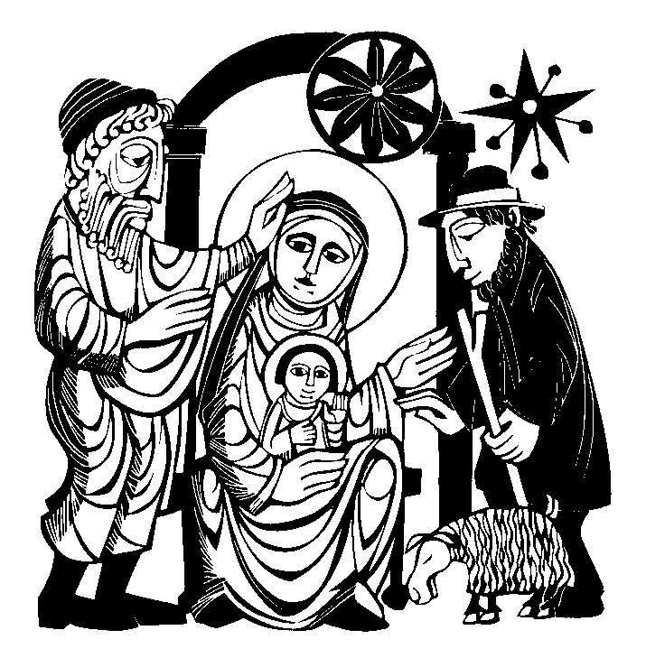
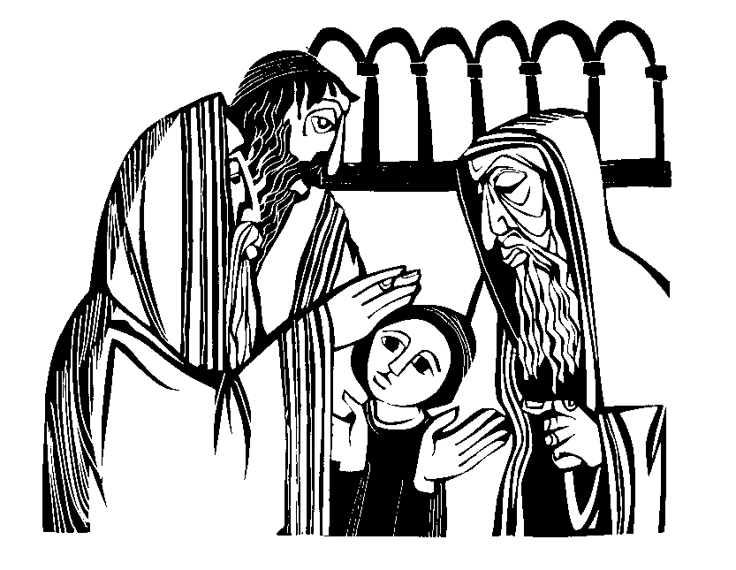
We Listen
Working together in the light of the lord
Once we have reflected on the joys in our lives we look to the life Jesus led:
Now look at the five pictures of the joyful events in Jesus’ family. Choose one of the five pictures and read the chosen scripture story which is on the next page. Any member of the family can read the story. Talk about the joyful moments of the story you have read together.
Look at all the pictures again. The stories they tell centre upon Jesus; four of them upon the events surrounding his birth and the fifth when he was a young boy. When we think about these joyful moments in the life of Jesus and his family, it helps us to remember that in the events of our family life Jesus is present with us.
The Annunciation
The Visitation
The Nativity
The Presentation
The Finding in the Temple

Slide 6
We Listen
Working together in the light of the lord
Once we have reflected on the joys in our lives we look to the life Jesus led:
The Annunciation
The Visitation
The Nativity
The Presentation
The Finding in the Temple
The Angel Gabriel was sent by God to Mary who lived in Nazareth. Mary was a little afraid at first but the angel said that he had come from God and God was very pleased with her. Gabriel had a message for her from God. God needed to send his Son to tell everyone about the kingdom of God. He would be born as a baby and needed a mother. God wanted Mary to be that mother. Mary wondered how it would all happen, but the angel assured her that the Holy Spirit would help her. Mary would do anything to please God and she said, “Yes”. The angel went quickly back to God.
Mary knew that her cousin was expecting a baby and she was quite old, so she went off into the hill-country to help Elizabeth, her cousin. She stayed there for some time and Elizabeth had a baby boy which she and her husband, Zachary, called John.
Shortly before Mary had her baby, she and Joseph, her husband, had to make a long journey to a city called Bethlehem. When they arrived in Bethlehem, it was full of visitors and Joseph had great difficulty finding a place for them to stay. Eventually, a kind inn-keeper showed them a shed where the animals slept. Joseph was grateful for a dry place with warm hay to go to sleep on. During that night Mary had her baby. She and Joseph called him Jesus.
Some days after Jesus was born, Mary and Joseph took their baby to the temple. All parents did this when they had a new baby boy. While they were there they met two old, kind people. Both of them had been waiting to see Jesus and they recognised him in his parents’ arms. The old man, Simeon, took Jesus in his arms and blessed him. He blessed Mary and Joseph as well. Before they took their baby home with them, they gave the temple-official a pair of turtle doves (like pigeons) as an offering.
Jesus lived with Mary and Joseph in Nazareth and learnt many things from both his parents. Every year they went to Jerusalem to pray with everyone else in the temple. It was the feast of the Passover. The men and older boys prayed in one area and the girls and women were in another. When it was all over everyone went home. After three days Mary and Joseph met up and Jesus was not with them. They were very worried and upset and immediately returned to Jerusalem to find him. He was about twelve years old. Finally they found him talking to all the learned men and asking them questions. Mary and Joseph were very relieved to find him, and asked him what he thought he was doing. Jesus answered, “I must be doing my Father’s work”. They all went home happily.

Slide 7
We Respond
Working together in the light of the lord
Now we have discussed the stories of Jesus’ life we use our rosary to pray.
Our Father, who art in heaven,
hallowed be thy name.
Thy kingdom come.
Thy will be done on earth as it is in heaven.
Give us this day our daily bread,
and forgive us our trespasses as we forgive those who trespass against us
and lead us not into temptation, but deliver us from evil. Amen
Hail Mary, full of grace,
the Lord is with thee.
Blessed art thou among women,
and blessed is the fruit of thy womb, Jesus.
Holy Mary, Mother of God,
pray for us sinners,
now and at the hour of our death. Amen
Glory be to the Father
and to the Son,
to the Holy Spirit,
as it was in the beginning,
is now, and ever shall be,
world without end. Amen
When we pray the rosary we remember the events of the life of Jesus and Mary, his mother.
We call these the mysteries of the rosary.
As we think about these events we ask Mary to pray with us and for us. Choose one of the Joyful Mysteries of Jesus’ life from the previous page.
One member of the family now holds the rosary.
For each mystery we say 1 Our Father, 10 Hail Marys, 1 Glory be to the Father.
(The diagram on the left shows us one decade, one mystery)
As you say each prayer of the decade we move from bead to bead to count the prayers.
As you pray the decade of the rosary think about what happened to Jesus and his family. As you do this, pray for your family and for all families throughout the world.
One decade of the rosary

Slide 8
We are sent forth
Working together in the light of the lord
Remember that we are part of God’s family, and that we should always pray for all families around the world. Try and say a decade of the rosary each day with your family.
Finish your prayer by making the sign of the cross.

