Slide 1
Where the Spirit Leads… A Scriptural Exploration
Dr Mary Marshall
Faculty of Theology and Religion, University of Oxford and St Benet’s Hall.

Slide 2
Galatians 5:17-18
For what the flesh desires is opposed to the Spirit, and what the Spirit desires is opposed to the flesh; for these are opposed to each other, to prevent you from doing what you want. But if you are led by the Spirit, you are not subject to the law.

Slide 3
Structure
Brief remarks on Terminology
Two themes: case studies in cross-Biblical exploration of the action of the Spirit in leading human lives:
Setting Apart
Empowerment
Comment on Galatians 5:18
All Biblical quotations are taken from the NRSV, unless otherwise stated.

Slide 4
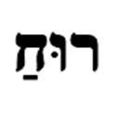
Terminology
ruach
pneuma
Breath, wind or spirit
dynamic; moving
The wind [pneuma] blows where it chooses, and you hear the sound of it, but you do not know where it comes from or where it goes. So it is with everyone who is born of the Spirit [pneuma]. (Jn 3:8)

Slide 5
Setting Apart
Ezekiel
The hand of the Lord came upon me, and he brought me out by the spirit of the Lord and set me down in the middle of a valley; it was full of bones. (37:1)
Thus says the Lord God: Come from the four winds [ruach], O breath,[ruach] and breathe upon these slain, that they may live.” I prophesied as he commanded me, and the breath [ruach] came into them, and they lived, and stood on their feet, a vast multitude. (37:9-10)

Slide 6
Setting Apart
Ezekiel 37:11-14
Mortal, these bones are the whole house of Israel. They say, ‘Our bones are dried up, and our hope is lost; we are cut off completely.’ Therefore prophesy, and say to them, Thus says the Lord God: I am going to open your graves, and bring you up from your graves, O my people; and I will bring you back to the land of Israel...I will put my spirit within you, and you shall live, and I will place you on your own soil.

Slide 7
Setting Apart
Jesus in Luke (Matthew and Mark)
And the Spirit immediately drove him out into the wilderness.” (Mark 1:12)
And Jesus was led up by the Spirit into the wilderness” (Matt. 4:1)
“Jesus, full of the Holy Spirit, returned from the Jordan and was led by the Spirit in the wilderness.” (Luke 4:1)

Slide 8
Setting Apart
Jesus’s Sonship in Luke
…and the Holy Spirit descended upon him in bodily form like a dove. And a voice came from heaven, “You are my Son, the Beloved; with you I am well pleased. (Lk 3:22)
The devil said to him, “If you are the Son of God, command this stone to become a loaf of bread.” Jesus answered him, “It is written, ‘One does not live by bread alone.’” (Lk 4:3-4)

Slide 9
Setting Apart
Spirit and anointing in Luke
The Spirit of the Lord is upon me, because he has anointed me to bring good news to the poor. He has sent me to proclaim release to the captives and recovery of sight to the blind, to let the oppressed go free, to proclaim the year of the Lord’s favour.”
…Then he began to say to them, “Today this scripture has been fulfilled in your hearing.” (4:18…21)

Slide 10
Setting Apart
Spirit and Election
For we know, brothers and sisters beloved by God, that he has chosen you, because our message of the gospel came to you not in word only, but also in power and in the Holy Spirit and with full conviction. (1 Thess 1:4-5)

Slide 11
Empowerment
Elijah and Elisha
Elijah said to Elisha, “Tell me what I may do for you, before I am taken from you.” Elisha said, “Please let me inherit a double share of your spirit.” (2 Kgs 2:9)
When the company of prophets who were at Jericho saw him at a distance, they declared, “The spirit of Elijah rests on Elisha.” (2 Kgs 2:15)

Slide 12
Empowerment
Charismatic judges and prophets
the spirit of the Lord rushed on [Samson], and the ropes that were on his arms became like flax that has caught fire, and his bonds melted off his hands. Then he found a fresh jawbone of a donkey, reached down and took it, and with it he killed a thousand men. (Judg. 15:14-15)
And the spirit of God came upon Saul in power when he heard these words, and his anger was greatly kindled. He took a yoke of oxen, and cut them in pieces. (1 Sam 11:6-7)

Slide 13
Empowerment
Charismatic judges and prophets
The spirit of God possessed [Saul], and he fell into a prophetic frenzy along with them. When all who knew him before saw how he prophesied with the prophets, the people said to one another, “What has come over the son of Kish? Is Saul also among the prophets? (1 Sam 10:10-11)

Slide 14
Empowerment
Baptism in the Holy Spirit
I am sending upon you what my Father promised; so stay here in the city until you have been clothed with power from on high. (Lk 24:49)
John baptized with water, but you will be baptized with the Holy Spirit not many days from now….But you will receive power when the Holy Spirit has come upon you; and you will be my witnesses in Jerusalem, in all Judea and Samaria, and to the ends of the earth. (Ac 1:5…8)

Slide 15
Empowerment
The Spirit and Speech in Acts
they could not withstand the wisdom and the Spirit with which [Stephen] spoke. (6:10).
While Peter was still thinking about the vision, the Spirit said to him, “Look, three men are searching for you. (10:19 cf 8:29; 11:12; 13:2).

Slide 16
Empowerment
The Spirit and relocation in Acts
When they came up out of the water, the Spirit of the Lord snatched Philip away; the eunuch saw him no more, and went on his way rejoicing. (Ac 8:39)
So, being sent out by the Holy Spirit, they went down to Seleucia; and from there they sailed to Cyprus. (Ac 13:4)
[Paul and Timothy] went through the region of Phrygia and Galatia, having been forbidden by the Holy Spirit to speak the word in Asia. (Ac 16:6)

Slide 17
Galatians 5:17-18
For what the flesh desires is opposed to the Spirit, and what the Spirit desires is opposed to the flesh; for these are opposed to each other, to prevent you from doing what you want. But if you are led by the Spirit, you are not subject to the law.

Slide 18
Galatians
The situation in Galatia(?)
I am astonished that you are so quickly deserting the one who called you in the grace of Christ and are turning to a different gospel (Gal 1:6)
Listen! I, Paul, am telling you that if you let yourselves be circumcised, Christ will be of no benefit to you. Once again I testify to every man who lets himself be circumcised that he is obliged to obey the entire law. (Gal 5:2-3)

Slide 19
Galatians
Paul’s Response
I do not nullify the grace of God; for if justification comes through the law, then Christ died for nothing. (Gal 2:21)
Did you receive the Spirit by doing the works of the law or by believing what you heard? Are you so foolish? Having started with the Spirit, are you now ending with the flesh? Did you experience so much for nothing? (Gal 3:2-4)
For if the inheritance comes from the law, it no longer comes from the promise; but God granted it to Abraham through the promise. (Gal 3:18)

Slide 20
Galatians
Fruits of the Spirit
By contrast, the fruit of the Spirit is love, joy, peace, patience, kindness, generosity, faithfulness, gentleness, and self-control. There is no law against such things. And those who belong to Christ Jesus have crucified the flesh with its passions and desires. If we live by the Spirit, let us also be guided by the Spirit. Let us not become conceited, competing against one another, envying one another. (Gal 5:22-26)

Slide 21
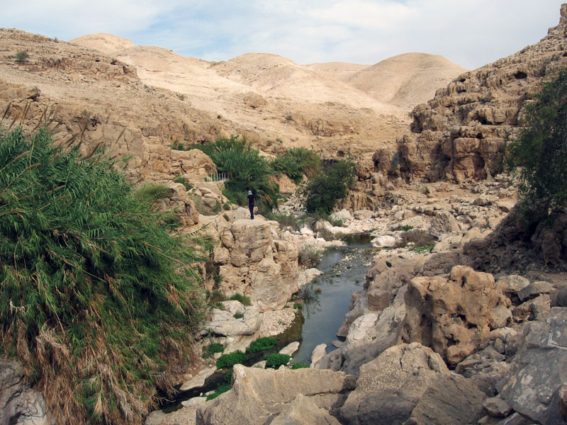
A Scriptural Exploration
Image copyright: Maglanist at en.wikipedia

