Slide 1
Chaplaincy and Adolescent Mental Health Issues

Slide 2
AIMS
To help us understand the link between spirituality, faith and mental health
To consider ways of encouraging and developing positive attitudes to mental health
To discuss mental health issues that face us and ways in which we, as chaplains, can help support, connect with and love those who are suffering

Slide 3
What one thing do you want to go away with?
If you could ask only one question what would it be?

Slide 4
Put your hand up if…
You have feelings of anxiousness about things
You have ever felt that other people are better than you
You have worried about how much you need to achieve today
You have ever gone home and said “I need a drink”
You have felt devalued, rejected, discriminated against because of gender, race, religion, political views

Slide 5
Mental health/mental wellbeing
How well are you feeling?
How well can you cope with day to day life?
Are your coping mechanisms helpful or unhelpful in the long term?

Slide 6
“My form teacher told me to come and speak to the Chaplain”

Slide 7
Scary statistics...

Slide 8
20% of adolescents may experience a mental health problem in any given year.¹
50% of mental health problems are established by age 14 and 75% by age 24.²

Slide 9
¹WHO (2003). Caring for children and adolescents with mental disorders: Setting WHO directions. [online] Geneva: World Health Organization. Available at:
²Kessler RC, Berglund P, Demler O, Jin R, Merikangas KR, Walters EE. (2005). Lifetime Prevalence and Age-of-Onset Distributions of DSM-IV Disorders in the National Comorbidity Survey Replication. Archives of General Psychiatry, 62 (6) pp. 593-602.
³Green,H., Mcginnity, A., Meltzer, Ford, T., Goodman,R. 2005 Mental Health of Children and Young People in Great Britain: 2004. Office for National Statistics.
⁴Children’s Society (2008) The Good Childhood Inquiry: health research evidence. London: Children’s Society

Slide 10
When psychological symptoms cause major emotional distress, or interfere substantially with daily life and social interactions over a period of time, professional evaluation is warranted, just as it is with any serious illness..
Know who you can pass on to

Slide 11
Words of caution
Unless you are a trained counsellor you are not a trained counsellor!
Make sure you know your safeguarding procedures
Never ever offer complete confidentiality

Slide 12
The Good News!
Most young people are not clinically depressed
Most young people do not hear voices
Most young people are not suicidal
Most young people do not have a diagnosable mental illness

Slide 13
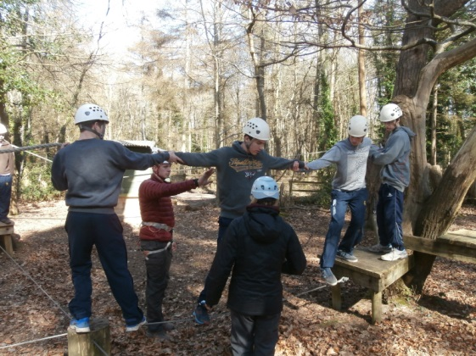
Most young people are just adolescents trying to negotiate their way through a changing body with raging hormones, a developing brain within an ever changing world

Slide 14
All young (and old!) people need to look after their mental health
Need to help young people to understand and deal with the developmental processes they are going through

Slide 15
So what is our role as Chaplains?

Slide 16
We need to teach and example good mental health habits

Slide 17
SELF CARE

Slide 18
Adolescent mental health is greatly affected by
Lack of a sense of belonging or connectedness – leads to low self worth/self esteem
Feelings of shame and guilt – borne out of confusion/misunderstanding/actions
Anger – can lead to inappropriate actions
Sadness – often diagnosed by staff/parents as depression- some depression is good depression

Slide 19
RD Laing: “Insanity is a perfectly rational adjustment to an insane world.”
How do we help our young people to make sense of their world?

Slide 20
Chaplain as “guardian of spiritual treasures”
St Martin of Tours – as a young Roman soldier in Amiens in 339 he cut his cloak in half to give to a beggar.
The cloak was known in Latin as a ‘cappella’. It was worn for the swearing of oaths and was carried into battle. It was a representation of the spiritual dignity of each person. Cloaks were kept in a tent or building that became known itself as a ‘cappella’ or chapel. Looking after this place was a ‘cappellano’ or chaplain. The ‘cappellano’ controlled access to the chapel, said prayers for the community there and organised spiritually significant events there.

Slide 21
What “spiritual treasures” do we guard that will help teach and resource our children to “have life and have it abundantly” ?
Realism – life is tough – Gospel does not promise happiness but ‘Abundant life’
Teach about feelings/about what it is to be human/how their brains/bodies work
Teach the Bible – source of comfort, wisdom, reassurance
Provide space/ways of being/opportunities for prayer

Slide 23
Many of our young people feel alone/feel that they don’t belong/disconnected
What happens when we disconnect?
Professor Peter Cohen ‘If we can’t connect to each other we will connect with anything we find’

Slide 24
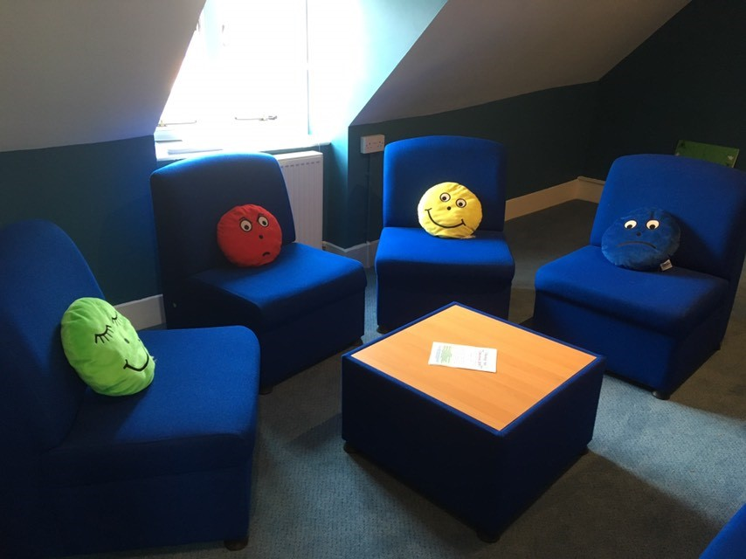

Slide 25
Genesis 3
And they heard the sound of the Lord God walking in the garden in the cool of the day, and Adam and his wife hid themselves from the presence of the Lord God among the trees of the garden.
Then the Lord God called to Adam and said to him, “Where are you?”
So he said, “I heard Your voice in the garden, and I was afraid because I was naked; and I hid myself.”

Slide 26
Where are you?
We need to ask that question of ourselves before we can help others
Help young people identify where they are, where they belong, where they would like to belong
Need to recognise when a young person is ‘no longer there’

Slide 27
‘I was afraid because I realised I was naked and I hid’
Shame
Guilt
Nakedness
Bring into the light
Connect again

Slide 28
Vow of stability
Anchor our young people
Stabilise them
Locate where they are

Slide 29
Vow of obedience
Obedience – pay attention to, give ear to, listen to
"You cannot truly listen to anyone and do anything else at the same time." --M. Scott Peck
"We have two ears and one tongue so that we would listen more and talk less." --Diogenes

Slide 30
How much time do we give to listening?
Do you worry about having the right answer/making the correct diagnosis/filling in the paperwork with enough detail etc
With mental health issues do we hear certain words and stop listening and think about passing it on to the appropriate agency?
Do we listen to ourselves – how is this issue making us feel/act – why might that be?

Slide 32
Conversion of manners Conversion of life
Ability to adapt to change
Ability to refresh/persevere not become complacent
Resilience
Bouncebackability
Ability to adjust to changing relationships

Slide 33
Recommended books

Slide 35
What is the Gospel we are called to live?
Forgiveness
Redemption
Second chances
Unconditional love
Not in our own strength

Slide 37
published in 1947, yet the themes of innocence, identity, loss of connection and angst mean that Holden could be speaking today.

Slide 38
Identify those emotions

